Slide 1

Project Presentation
Joseph McCrae – xkp328
Erick Estrella – bhm049
Obada Musa – nqw828
Gabriel Tabar – kkx410
Jackson Collins – zxh677

Slide 2
Steps to Solve Project
Identify the Problem:
Discussed the code, documentation, and presentation.
Planning:
Established group meeting time and location (After DS Class, CS Main Lab)
Create repo to upload updated versions for accessibility.
Discovered first requirements: Program constructors for ResourceManagement and Department classes.
Start early on documentation for future success in the presentation and document.

Slide 3
Steps to Solve Project (continued)
Code Development:
Every meeting, discussed which members to code next requirements.
Debugging:
Collaborated on potential solutions for discovered bugs in code.
Compared our output to the example output to find logic errors.
Test code on UTSA Fox Servers to determine compatibility.
Address any issues or complications in the code for the next steps.

Slide 4
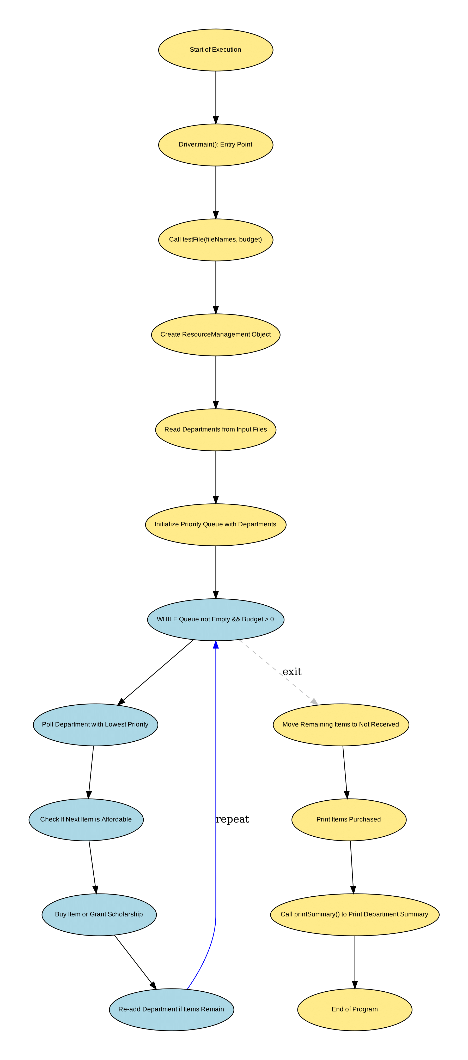

Slide 7

Group Meeting Details
Group meetings happened nearly every Tuesday and Thursday after Data Structures class in the CS Main Lab.
During every meeting, we:
Discussed the current version of the code.
Updated documentation with new contribution details.
Discussed next steps to completing the project.
Issues that were discovered, we addressed immediately, such as:
Implementing scholarships.
Fixing priority in each department.
Logical errors in the code output and the expected output.

Slide 8
Group Participation Details
Joseph McCrae
Lead group meetings and discussions related to the project.
Primarily documented development of program and group member contribution.
Ran and tested version of code on Eclipse, discovering potential bugs and logic errors.
**Coded and submitted Assignment 4 during project duration.
Erick Estrella
Primarily focused on the ResourceManagement class, especially on programming the constructor.
Collaborated and updated the printSummary() method.
Frequently coded and uploaded version to repo to test.

Slide 9
Group Participation Details (Continued)
Obada Musa
Primarily programmed the printSummary() method in the ResourceManagement class.
Fixed a logic error in the program output.
Completed flowchart for project presentation.
Gabriel Tabar
Primarily coded the constructor for the Department class.
Made small revisions to the ResourceManagement constructor.
Jackson Collins
Initially, started the ResourceManagement constructor.
Debugged incompatible methods with UTSA Fox Server.

Slide 10
Q&A

